Slide 1
Australian Paper, Amcor, Rio Tinto, Simplot, Wesfarmers, Westfield, Woolworths
(Rule Change Committee)
Briefing to AEMC Forum
23 November 2011
The Chifley, Brisbane

Slide 2
Contents
Introduction to the Committee
Statement of the problem
Elements of a solution
The Committee’s proposals

Slide 3
About the Committee
Consists of representatives from Australian Paper, Amcor, Rio Tinto, Simplot, Wesfarmers, Westfield, Woolworths. Committee members are also members of the Energy Users Association of Australia.
Formally constituted in April 2011, after six months of preparation.
Chairman elected by Committee. All major decisions by consensus.
Committee members have fully funded and governed this rule change proposal
Committee is motivated to make a constructive contribution to Australia’s energy regulator frameworks and guided by the pursuit of the National Electricity Objective (long term interest of (all) consumers)

Slide 4
What is the problem ?
The regulatory allowance for the return on debt for regulated network service providers in the NEM is significantly higher than the cost of debt, particularly for those NSPs owned by state governments.
This has resulted in:
  excessive profits for network service providers at the expense of higher prices for energy users;
  incentives to over-invest in order to expand the asset base and maximise profits.
The reason for this outcome is, primarily, flawed Rules.

Slide 5
Evidence of the difference between the cost of debt and allowed return on debt (privately owned NSPs) (1)
AER determination of allowed return on debt for NEM distributors
Regulated return on debt for distributors in NZ and GB
Yield to maturity (at issue) for 5 year bonds issued by members of our committee
Actual of cost of debt for private and government distributors
Source: Regulatory decisions, term sheets, CME analysis

Slide 6
Evidence of the difference between the cost of debt and allowed return on debt (privately owned NSPs) (2)
Source: ASX announcements, CME analysis
Data on recently issued bonds suggests 191 basis point difference between yield to maturity at issue, and AER allowed return on debt. Furthermore the evidence of issued bonds and bank debt by SPI, DUET and Spark Infrastructure in 2008 and 2009 does not support the claim that debt costs for regulated utilities were materially higher during the GFC.

Slide 7

Evidence of the difference between the cost of debt and allowed return on debt (privately owned NSPs) (3)
Five-yearly rolling average yield to maturity of 5 year corporate bonds issued in Australia
Source: CEPA
By comparison, AER has allowed ~ 9% return on debt.

Slide 8
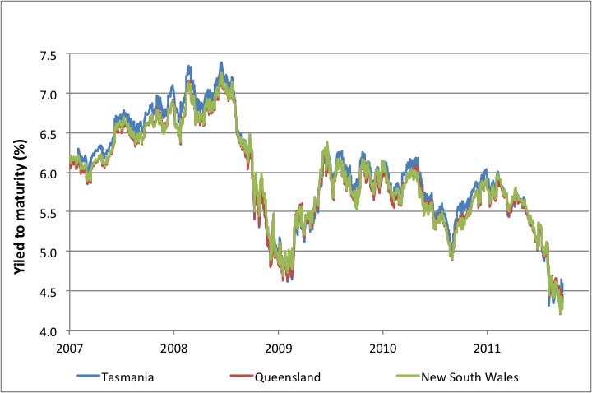
Evidence of the difference between the cost of debt and allowed return on debt (government-owned NSPs)
Actual cost of debt clearly substantially below the circa 9% allowed return on debt
Source: CEPA

Slide 9
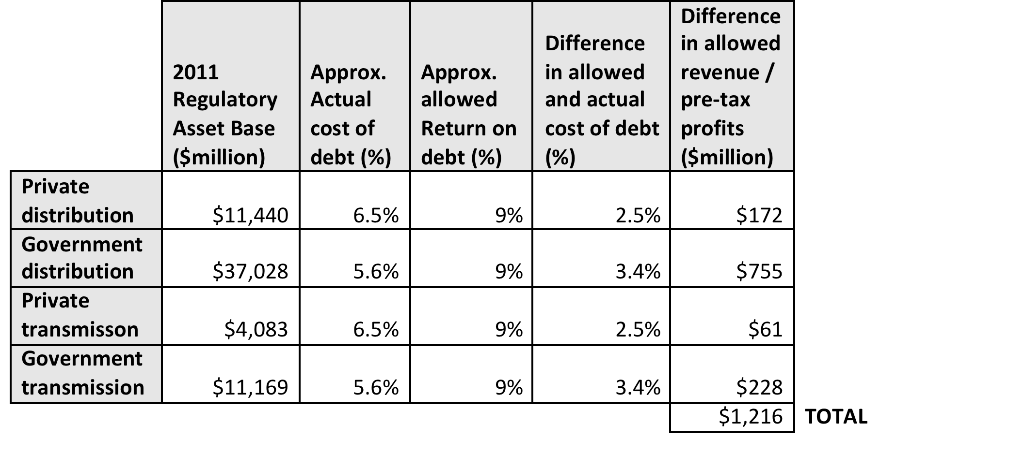
This has translated into windfalls for shareholders and higher prices for consumers …
Excessive allowed return on debt has translated in to network prices around 12% higher than they would be if based on the cost of debt

Slide 10
… and incentives for inefficient over-investment
Margins on debt, particularly for government-owned NSPs, has encouraged more capital spending than necessary

Slide 11
And, the main reason for this is an inappropriate Rule
The AER has discretion to set benchmark credit rating and term (during each price review for distribution and in the Statement of Regulatory Intent for transmission). Some improvement may be made through an appropriate choice of these parameters (and this does not require a Rule change).
But, the Rules bind the AER to a specific and inappropriate calculation of both the risk free rate and the debt risk premium. And the Rule fails to adequately take account of actual debt costs. Changes to the Rule is needed to rectify this.

Slide 12
Elements of a solution
Scope of comparators (just network businesses, or some or all other corporates, Australia only or international as well ?)
Maturity (5 or 10 year bonds – or longer or shorter ?)
Averaging period (over what period of time is the yield to maturity to be assessed ?)
Credit rating of debt (A, BBB, both, one, something specific ?)
Treatment of embedded debt (should the chosen rate reflect estimates only of forward debt costs or also take account of historic costs?)
Accounting for differences in funding and profit flows between privately-owned and government-owned businesses (government-owned NSPs have access to Treasury bonds, and state governments receive profits and taxes from their NSPs)

Slide 13
Some comments on specific aspects (1)
Scope of comparators:
  ideally electricity networks / regulated utilities only. But dataset too small to forced to look more widely;
  Australia only (challenges in translation of international markets back to Australia can be problematic).
Maturity:
  5 years is now the commonly accepted measure by Australian regulators.
  More than 2/3rds of network utility debt is payable in less than 5 years.
Averaging period:
  Debt markets can be volatile, use of a reasonable averaging period will deliver a more stable result;
  Allowed returns closer to the way that NSPs fund themselves reduces financeability risks
Credit rating:
  A broader range of credit ratings extends the data available and so reduces implementation problems;
  A high level of specificity (e.g. BBB+) seems unjustified when taking account of actual NSP bond ratings

Slide 14
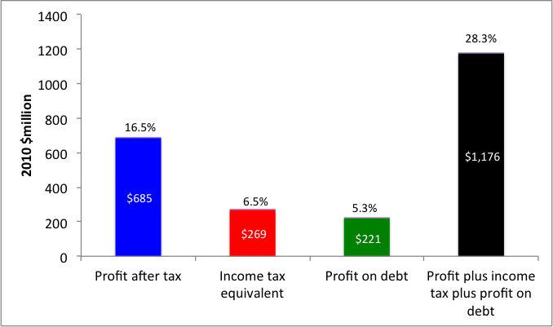
Some comments on specific aspects: government ownership
Is the existing discriminatory arrangement in favour of government-owned NSP’s justifiable?
  Competition Principles Agreement does not support treatment of government-owned NSPs as if they are privately owned. But tax payers should be compensated for NSP default risks that they are bearing.
  Finding the balance requires a wider examination of the profitability of NSPs to their government owners.
Pecuniary benefits to the NSW Government from its electricity distributors and retailers in 2010
NSW Government is receiving a Return on Equity of 28.3% - compared to AER’s intended regulatory determination of ~ 10.3 %.
Allowing a margin on actual cost of borrowing for government-owned NSPs can not be justified against the National Electricity Objective

Slide 15
The Committee’s proposals
Government-owned NSPs: Return on Debt for each year of the regulatory control period to be based on the average daily yield to maturity in the previous calendar year of all bonds issued by the relevant government (that owns the NSP) that have between 3 and 7 years to maturity.
Privately-owned NSPs: Return on debt for each year of the regulatory control period to be established based on an equal weighting of the average yield to maturity for the five years to the end of the last calendar year, of all broad BBB and A rated corporate debt issued in Australia.

Slide 16
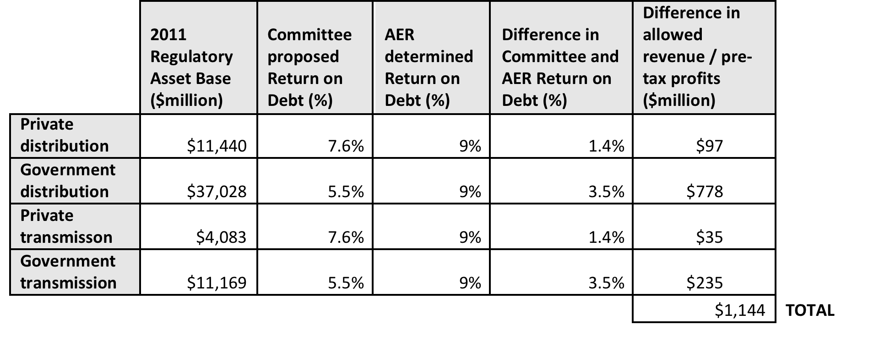
Implications of the Committee’s proposals
If (hypothetically) applied to all NSPs in 2011, this would result in a reduction of regulated revenues of around 11.5% and a reduction in retail prices of around 6.3%. But the Committee is not proposing to re-open existing decisions.

Slide 17
Our proposals on the return on debt differ from the AER’s
Valuable for rules on the allowed return on debt to be established, rather than to leave it to regulatory review:
  Essential to have a comprehensive review of the issues against the NEO criterion and to involve all interested parties in an issue with a high level of policy content;
  Greater investment and price certainty;
  Transparent action to address regulatory concerns.

Slide 18
Contact Details
Policy & General Enquiries Technical / Economic Enquiries
Brian Green Bruce Mountain
Australian Paper Carbon Market Economics
Chairman Project Manager / Technical Director
Network Rule Change Committee Network Rule Change Committee
Tel 03 8540 2384 Tel 03 9664 0680
Mob 0407 804 490 Mob 0405 505 060
brian.green@australianpaper.com.au bruce.mountain@carbonmarkets.com.au

